Slide 1

Evaluating US Socioeconomic Factors of COVID-Confirmed Cases
STAT 415/615 Regression
Yunting Chiu, Chi Yun Liu, Ana Lim
Notes:
The image: https://www.hopkinsmedicine.org/health/conditions-and-diseases/coronavirus/routine-vaccinations-wellness-visits-for-babies-and-kids-during-coronavirus-pandemic

Slide 2

00.
INTRODUCTION
01.
RESEARCH PROCESS
02.
ANALYSIS USING R
03.
CONCLUSION
04.
QUESTIONS
Brief introduction of our research
Discussion of literature review and the question of interest
Applying our research to conduct linear regression analysis using R
The conclusion of our analysis
Time for questions
Notes:
Ana: 0 & 1
Yunting & Chi-Yun: 2
Ana: 3

Slide 3


INTRODUCTION
According to the CDC report, “Health Equity Considerations and Racial Ethinic Minority Groups,” the COVID-19 pandemic has “... unequally affected many racial and ethnic minority groups, putting them more at risk of getting sick and dying from COVID-19” [4].
Our group research wanted to apply the regression methods we have learned in the course to specifically analyze the COVID-19 cases based on racial demographics and median income in the States.

Slide 4
01
ABOUT THE RESEARCH
Literature Review
Research Question
Selecting Variables

Slide 5
Literature Review
We evaluated three peer-reviewed research articles to set the premise for our research analysis:
The COVID-19 Pandemic and Health Inequalities [1]
Differences in Race and Other State-level Characteristics and Associations with Mortality from COVID-19 Infection [2]
Socioeconomic Determinants of Covid-19 Infections and Mortality: Evidence from England and Wales [3]
Key Concepts from Literature Review
Syndemic pandemic: a term that researchers of “The COVID-19 Pandemic and Health Inequalities” use to describe the socio-economic inequalities that contribute to health inequalities.
Racial demographic and health inequalities impact the infection and mortality outcome in a pandemic

Slide 6

Research Question: How do racial demographics influence COVID-19 cases?
Notes:
What are the variables that influence Y (Y = COVID-19 cases)

Slide 7
02
ANALYSIS USING R
COVID-19 Datasets
Data Analysis

Slide 8

DATASETS
COVID Data Scraping (CSSE at JHU)
2019 US State Population By Ethnicity (US Census)
2021 Household income (US Census Bureau)
Choosing variables according to the peer-reviewed papers [2] [3]

Slide 9
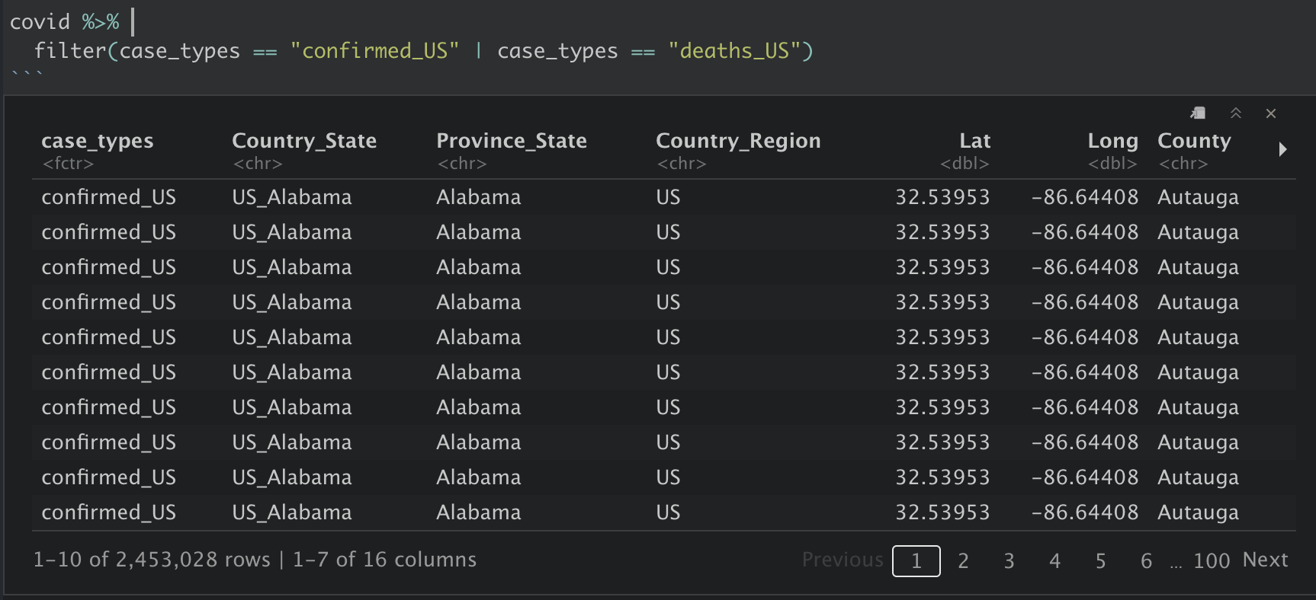
Raw Data from Johns Hopkins University

Slide 10
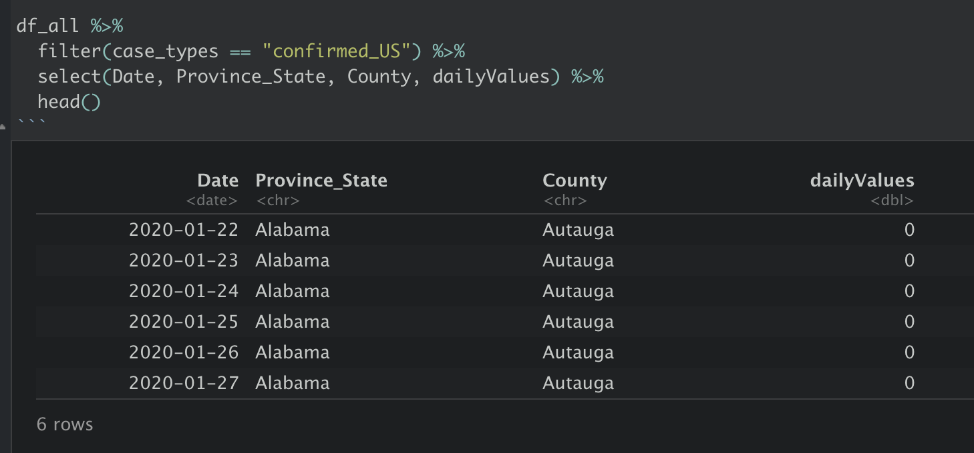
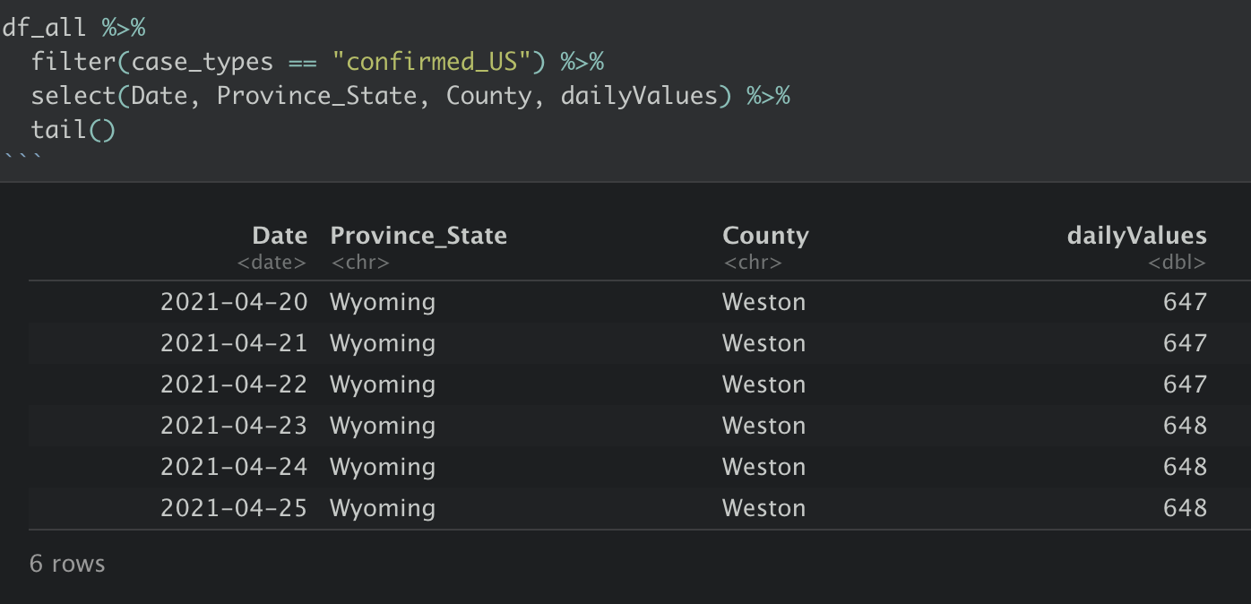
Time Series Data (Count by county)

Slide 11
We only focused on Confirmed Cases & Death Cases in the US from January 22, 2020 to January 22, 2021.
Racial demographics and median income were added as new variables.

Slide 12
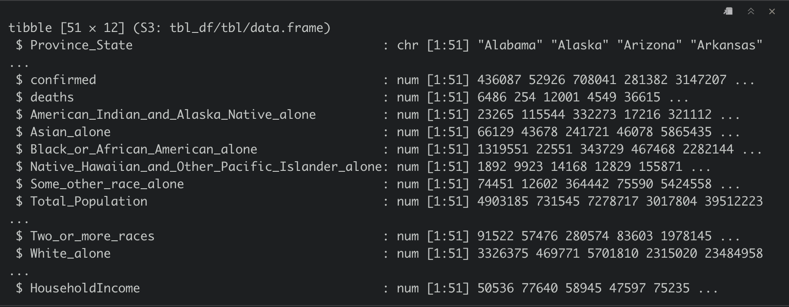
Exploratory Data Analysis
FULL MODEL
REDUCED MODEL

Slide 13
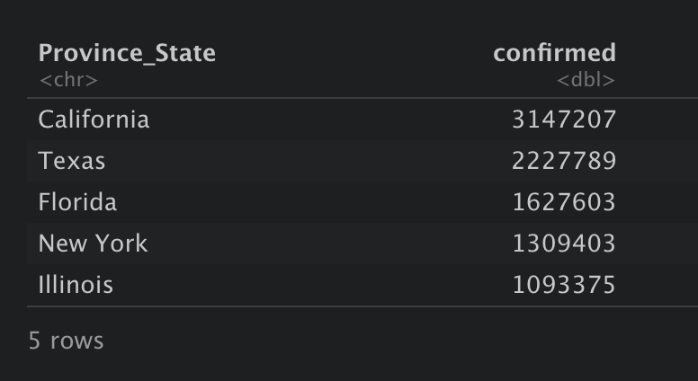
Top 5 Confirmed Covid-19 Cases
FULL MODEL
REDUCED MODEL
(Jan. 22, 2020 to Jan. 22, 2021)

Slide 14
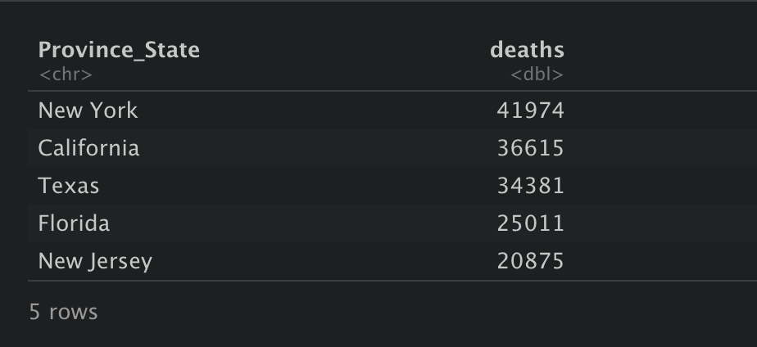
Top 5 Death Cases
FULL MODEL
REDUCED MODEL
(Jan. 22, 2020 to Jan. 22, 2021)

Slide 15
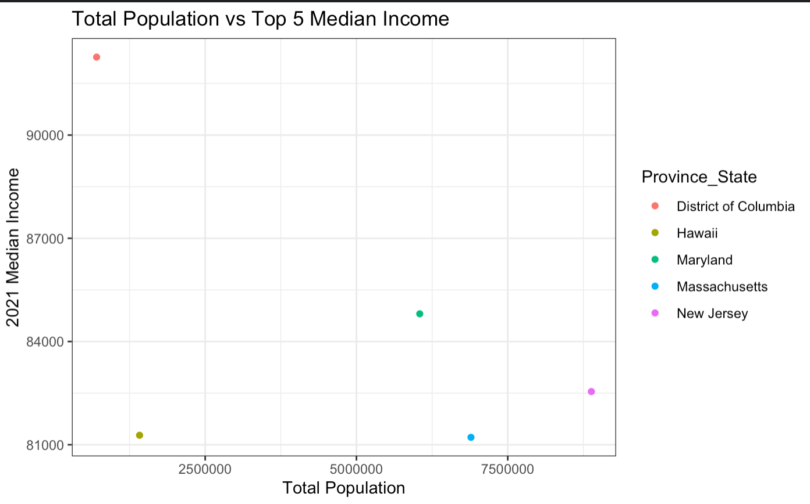
Data Visualization
FULL MODEL

Slide 16
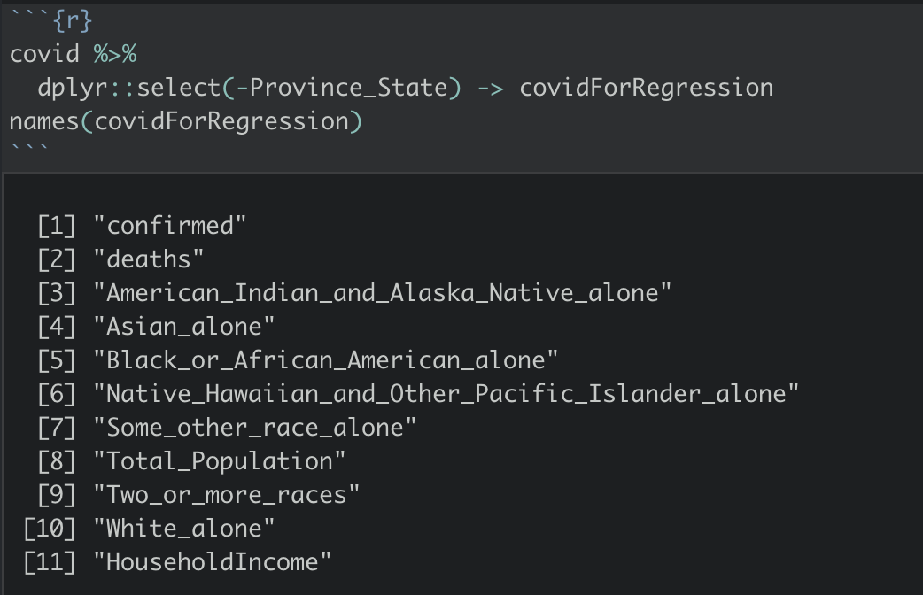
Dataset for Regression Model

Slide 17
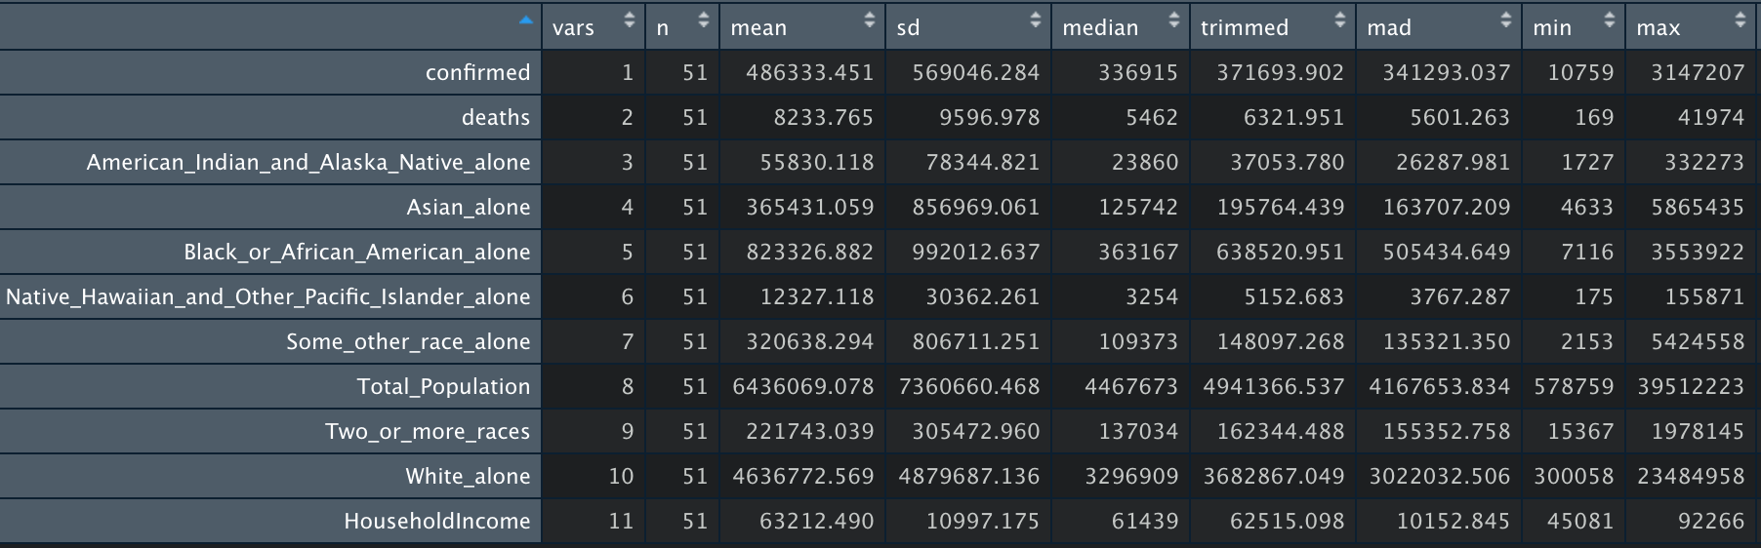
Descriptive Statistics

Slide 18
Descriptive Statistics

Slide 19
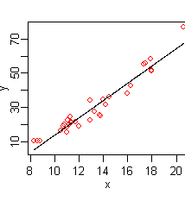
Linear Model Assumptions
Multicollinearity
Independence
Linearity
Homoscedasticity
Normality

Slide 20
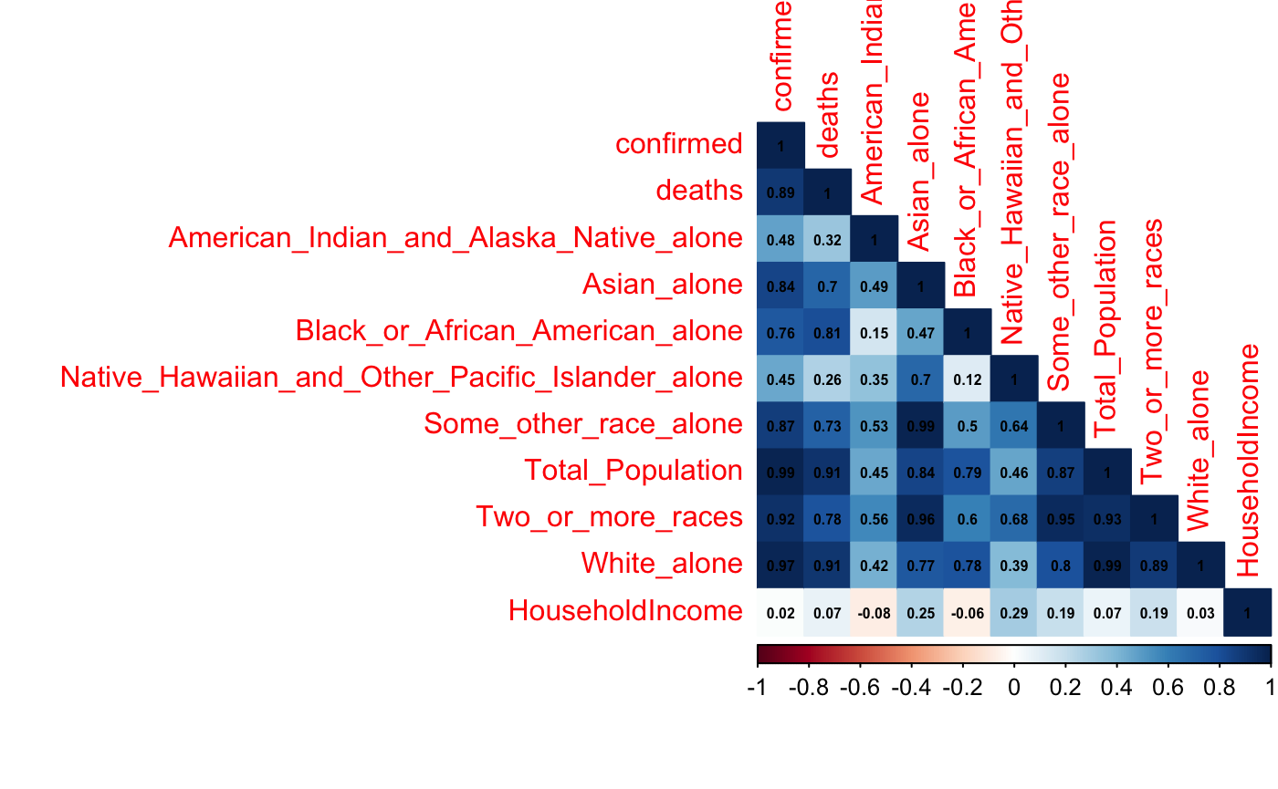
Multicollinearity

Slide 21
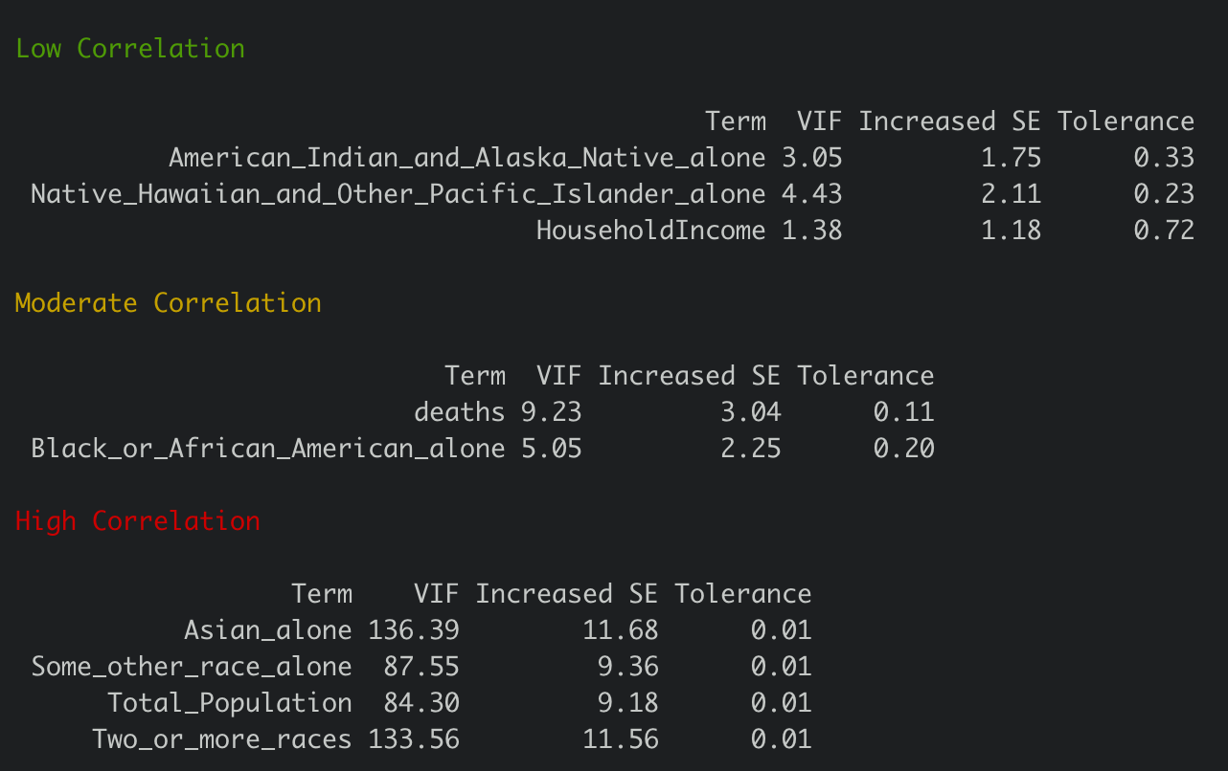
Multicollinearity
GOAL
Tolerance > 0.1
VIF < 10

Slide 22
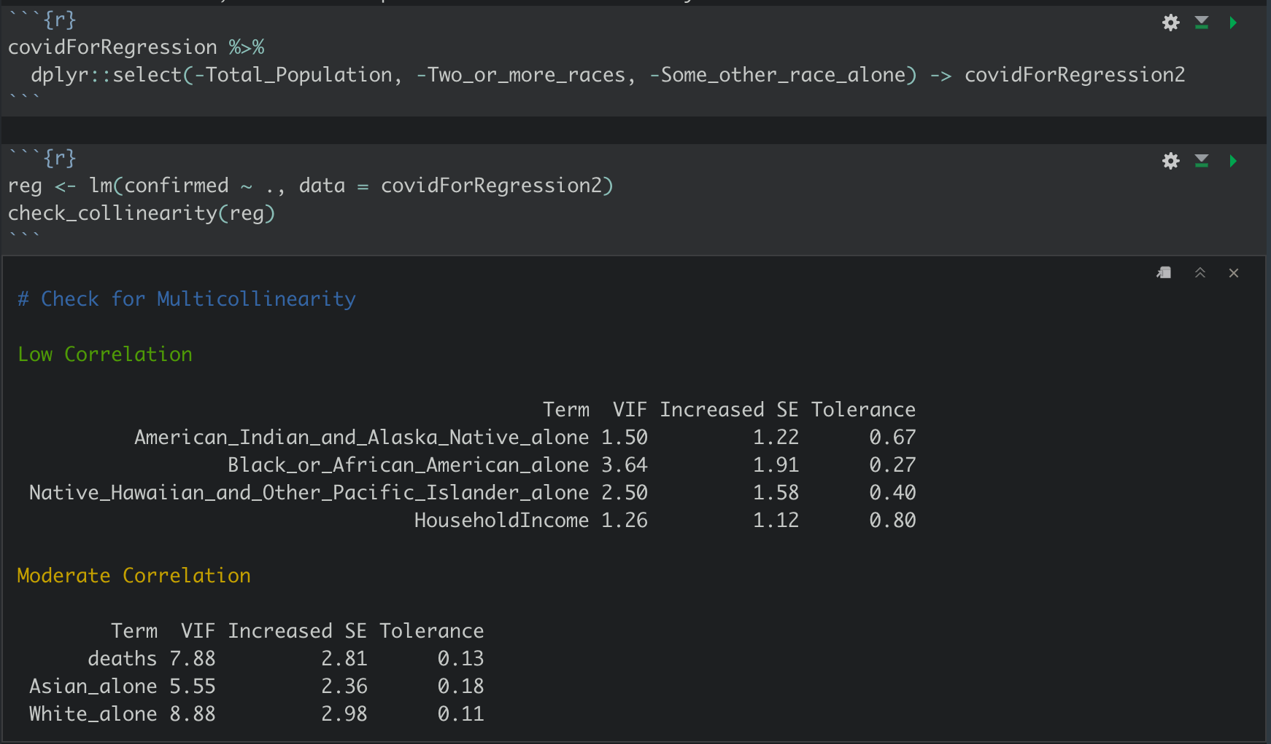
Remediation - Removing Highly Correlated Predictors

Slide 23
Remaining Variables
[1] "confirmed"
[2] "deaths"
[3] "American_Indian_and_Alaska_Native_alone"
[4] "Asian_alone"
[5] "Black_or_African_American_alone"
[6] "Native_Hawaiian_and_Other_Pacific_Islander_alone"
[7] "White_alone"
[8] "HouseholdIncome"

Slide 24
Independence
We would need to know more from the data providers to really assess this.
We will assume it holds.

Slide 25
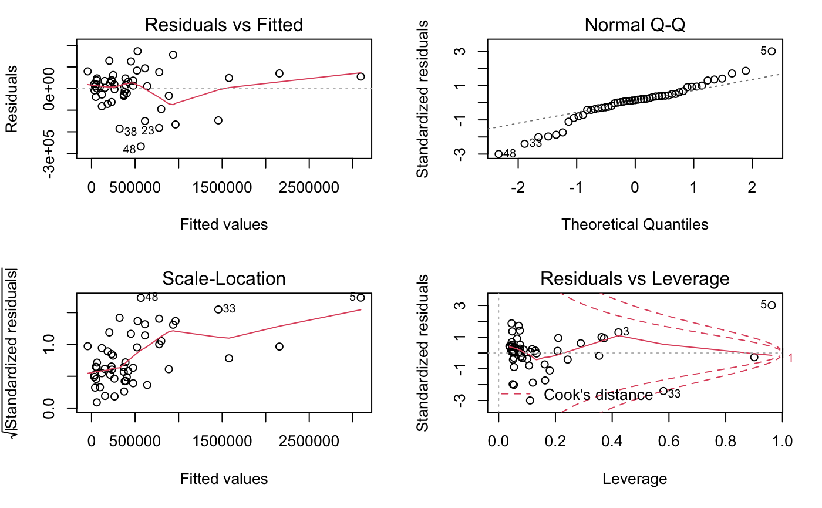
Linearity

Slide 26
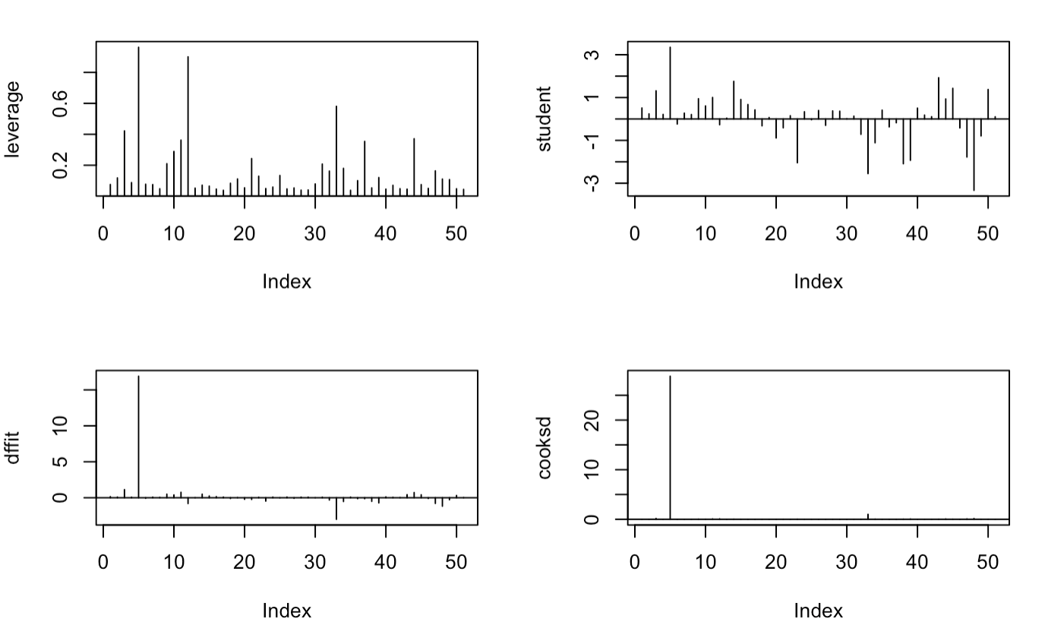
Remediation - Removing a Influential Outlier
Take away the largest values of cooks and leverage.

Slide 27
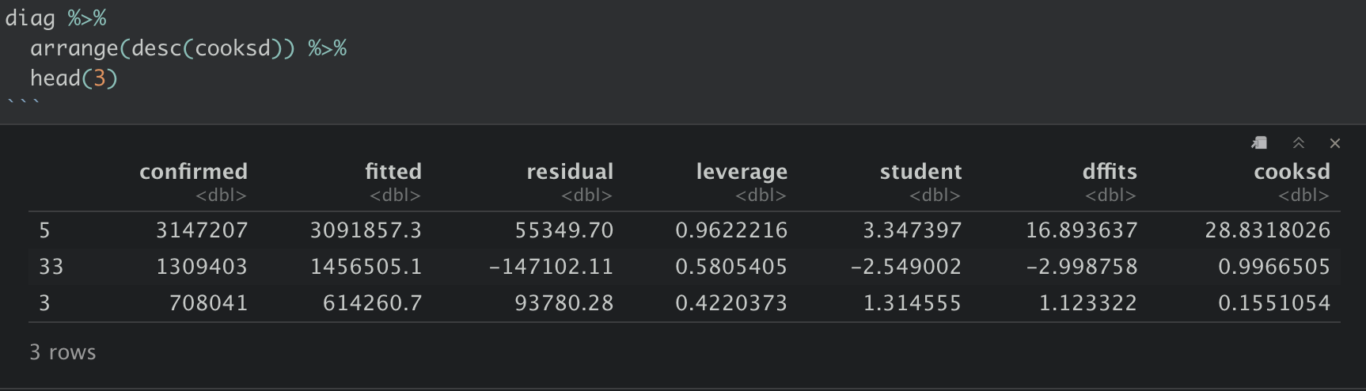
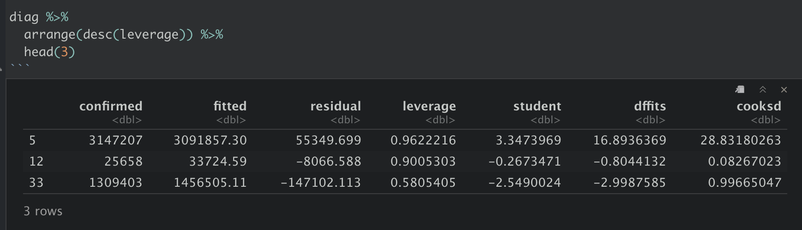
Remediation - Removing a Influential Outlier
That is, observations 5 (California) is no longer present.

Slide 28
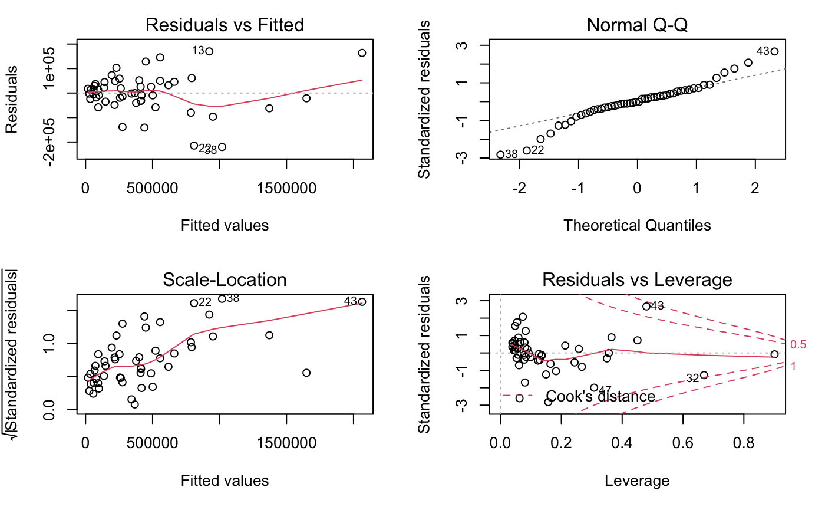
Look at the Residual vs Fitted plot
We see evidence for linearity

Slide 29
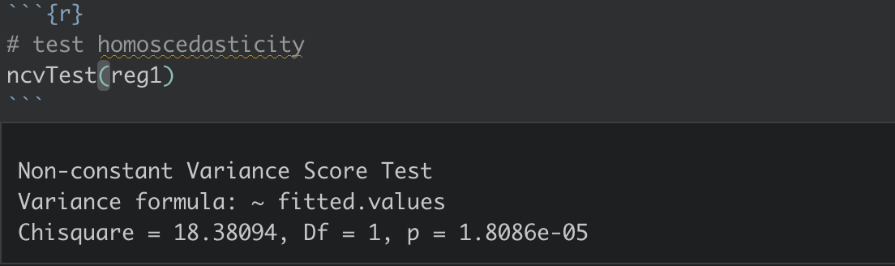
Homoscedasticity
With small p-value, we have evidence that the variances are non-constant

Slide 30
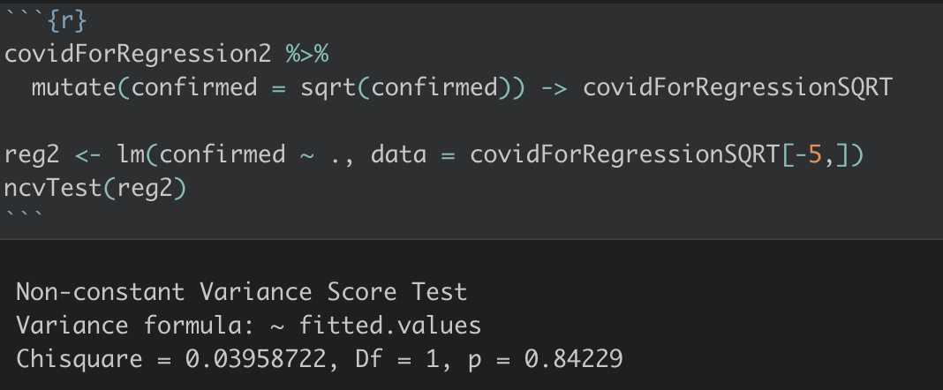
Remediation - Square Root of Y
With a high p-value of 0.84229, there is no evidence of non-constant variance.

Slide 31
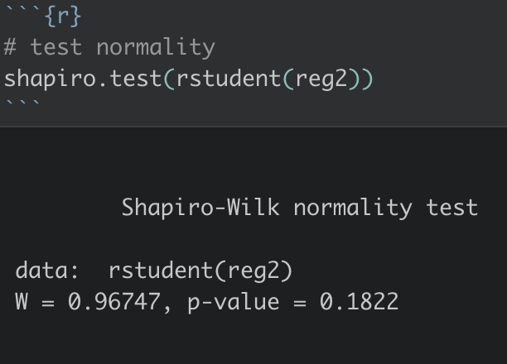
Normality
The p-value of the Shapiro-Wilk Test 0.1822 is greater than α = 0.05
The data is follow a normal distribution.

Slide 32

ANALYSIS FINDINGS
Based on our analysis, the racial demographics and household income in the US influence the number of COVID-19 infection cases.

Slide 33
Model Selection
Fewest predictors
Min. MSE
Exhaustive Search
Adjr2/CP ----> 5 variables
BIC ----> 4 variables
Sequential Search
Forward
Adjr2/CP ----> 6 variables
BIC ----> 2 variables
Backward elimination
Adjr2/CP ----> 5 variables
BIC ----> 4 variables
Stepwise Method(direction = “both”)
AIC=462.95 ----> 5 variables

Slide 34
Comparison
Exhaustive Search, MSE = 9863.275
Sequential Search Forward, MSE = 11211.07
Stepwise Method
(direction = “both”), MSE = 9375.065
Sequential Search Backward elimination, MSE = 9863.275
Fewest predictors
Min. MSE
Black_or_African_American_alone
White_alone
deaths
Asian_alone
Black_or_African_American_alone
White_alone
White_alone
Black_or_African_American_alone
deaths
Asian_alone
American_Indian_and_Alaska_Native_alone
deaths
Asian_alone
Black_or_African_American_alone
White_alone

Slide 35
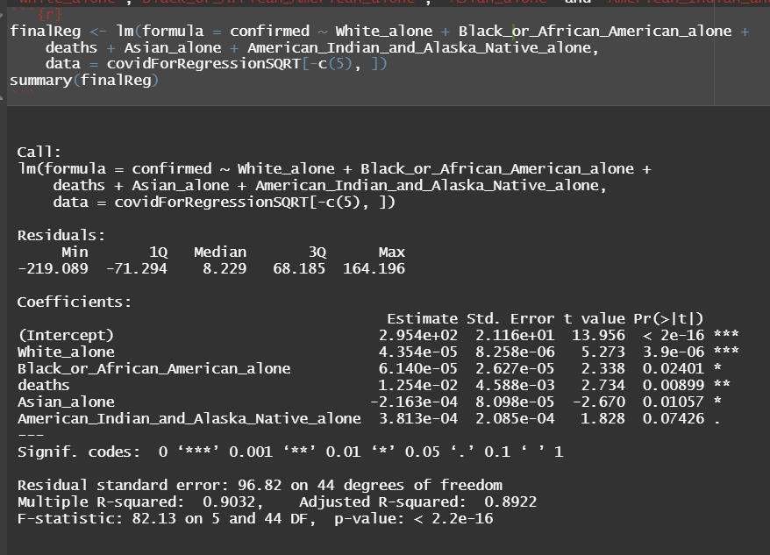
Best Model
Summary
Residual standard error : 96.82
Multiple R-squared :
0.9032
Adjusted R-squared :
(accuracy) 0.8922
P-value : < 2.2e-16

Slide 36
Model Equation
The expected value of square root of confirmed cases

Slide 37
03
CONCLUSION

Slide 38


CONCLUSIONS
Limitations of the Analysis:
The best model only takes into consideration the racial demographics in the US as predictor variables for confirmed Covid-19 cases. However, as we know, there are many socio-economic factors that should be taken into consideration to get a more accurate account such as education, income, and gender.
Strength of the Analysis:
On the other hand, since the model consists of specific racial demographics in the US as predictor variables, we are able to think more deeply about how racial demographics influence the confirmed cases of Covid-19 in the US.

Slide 39

THANKS YOU!
Do you have any questions?

Slide 40
REFERENCES
[1] Bambra, C., Riordan, R., Ford, J., & Matthews, F. (2020). The COVID-19 pandemic and health inequalities. Journal of Epidemiology and Community Health (1979), 74(11), 964–968. https://doi.org/10.1136/jech-2020-214401
[2] Sehra, S., Fundin, S., Lavery, C., & Baker, J. (2020). Differences in race and other state‐level characteristics and associations with mortality from COVID‐19 infection. Journal of Medical Virology, 92(11), 2406–2408. https://doi.org/10.1002/jmv.26095
[3] Sa, Filipa G., Socioeconomic Determinants of Covid-19 Infections and Mortality: Evidence from England and Wales (May 2020). CEPR Discussion Paper No. DP14781, Available at SSRN: https://ssrn.com/abstract=3612850
[4] Health equity considerations and racial and ethnic minority groups. (2021, April 21). https://www.cdc.gov/coronavirus/2019-ncov/community/health-equity/race-ethnicity.html

Slide 41
DATASETS
https://github.com/CSSEGISandData/COVID-19/tree/master/csse_covid_19_data/csse_covid_19_time_series
https://population.un.org/wpp/Download/Standard/CSV/
https://www.governing.com/now/State-Population-By-Race-Ethnicity-Data.html
https://www.census.gov/library/visualizations/interactive/2019-median-household-income.html

